Slide 1
Coursera IBM Capstone Project
Hospital Coverage for Traffic Collisions in Los Angeles
Author: Abhijit Deshpande
Date: 7 May 2020

Slide 2
Project Introduction
Problem Background
Victims of traffic accidents need to be quickly taken to the nearest hospital
Objective
Visualize last few year’s traffic collision history in Los Angeles
Identify the hospital coverage gaps
What percentage of recent traffic accidents occurred too far from the nearest hospital (outside hosp. coverage zones)?
Provide policy recommendations to Los Angeles administration
If the LA city administration can afford to open a few new hospitals, where should they be located in order to minimize the hospital coverage gaps?
Do the central regions of the city have higher intensity of accidents than the outskirts?
Scope, Target Audience and Assumptions
Scope : Analysis is limited to the city of Los Angeles
Assumptions: Resources like funds, space along with necessary permissions are assumed to be available for opening few new hospitals at proposed locations. It is assumed that future traffic collisions will follow similar pattern as last few years.
Target Audience: Local Administration of Los Angeles City and Private Players interested in opening new hospitals in LA
Assuming that Los Angeles city administration wants to open a few new hospitals for catering to traffic collision victims, this analysis aims to identify the optimum locations in order minimize hospital coverage gaps
Any individual hospital can provide timely health services only to accident victims located within a coverage radius of 10 to 12 km around it. The hospital coverage zone can be visualized as a circle with the hospital at the centre and radius as coverage radius, which is set at a distance of 12 km for the purpose of this analysis .
Having a hospital nearby the accident location can be the crucial difference between life and death
How many hospitals would need to be opened and where for reaching coverage target of (i)85%? and (ii)90%?
If the administration has resources to open 3 new hospitals, what coverage level can be achieved?

Slide 3
Data (1/3)
What data is required for this project?
Location data of last few year’s traffic collisions in Los Angeles city (2016 onwards)
Location of hospitals in Los Angeles city
Data Sources
Traffic Collision History
Public Dataset : Available from below link
https://data.lacity.org/
Hospital Locations
Foursquare API: The city is divided into search zones and browse for hospitals at each zone
Public Dataset: Available from below link
https://hub.arcgis.com/datasets/lacounty::hospitals-and-medical-centers

Slide 4
Data (2/3)
Data Processing Methodology
Traffic Collision History
Traffic Collision History
Dropped: Older records up to year 2015
Dropped: Most columns like accident date, victim details along with rows outside LA city limits
Latitude and Longitude are extracted to separate columns from a single column in the raw data
Hospital Locations
The city is divided into 8 search zones. Each search zone is a circle with radius 30 km. The centres of these search zones are set through trial and error using visual inspection of the map.
Foursquare API is used to browse for hospitals at each search zone. The API limits the results per zone to max 50.
The results from all the search zones are aggregated into a single hospital master table with removal of duplicates.
The public dataset lists hospitals from all cities in LA county. Hospitals are added to the master table using the public dataset, after limiting results by filtering latitude and longitude to get a bounded rectangle encompassing LA city.
Duplicates are removed to get the final table
Dropped columns: Dates, Victim Info, Crime Code, MO Codes, Premise Code etc.
Raw
Final
Dropped rows: Older records up to year 2015
Public Dataset
Feature Extraction: Extract separate ‘Lat’ and ‘Long’ columns from single ‘Location’ column
Location
(34.0508, -118.2731)
(33.8542, -118.2905)
Latitude | Longitude
34.0508 | -118.2731
33.8542 | -118.2905
Feature
Extraction
Hospital Locations
Filter lat and long: LA City Bounded rectangle
Search Zones
SZ1
Master Table
Raw
Foursquare API
Extract Name, Category
Lat and Long
Add hospitals from filtered data
Drop Duplicates
Public Dataset
(LA County)
SZ8
Final

Slide 5
Data (3/3)
Sample Final Data after Processing
Traffic Collision History
 | Area Name | Address | Cross Street | Latitude | Longitude
1 | Rampart | UNION | JAMES M WOOD | 34.0508 | -118.273
2 | Harbor | VERMONT | KNOX | 33.8542 | -118.291
3 | Hollywood | FRANKLIN AV | ARGYLE | 34.1052 | -118.325
4 | Southwest | LA BREA AV | JEFFERSON BL | 34.0255 | -118.3548
Hospital Locations
 | Name | Category | Lat | Long
1 | Ronald Reagan UCLA | Hospital | 34.0665 | -118.4465
2 | Healthline Medical Group / Urgent Care | Urgent Care Center | 34.1945 | -118.4642
3 | Santa Monica UCLA | Hospital | 34.0272 | -118.4865
4 | Sherman Oaks Hospital | Hospital | 34.1603 | -118.4495

Slide 6
Methodology
How is the data used to solve the problem?
Machine learning algorithms like regression and classification are not required for solving this problem
The problem is solved using a combination of visual inspection and quantification of coverage/coverage gaps
Folium library is used for map visualization and extracting coordinates of any location from the map
The objects used for quantification include GeoDataFrames and MultiPolygon objects which are applied to the historical traffic collision data superimposed on the hospital locations
Need to set appropriate coordinate reference systems to correctly calculate location within coverage zone and visualization on the map
Visualize hospital locations and collision intensity
Visualize the hospital coverage circles
Visualize existing coverage gaps and quantify them
Use visual inspection to propose the locations of new hospitals
Visualize the new coverage gaps and quantify them
Provide recommendations
Steps Followed
As – Is
Gap Analysis
To - Be

Slide 7
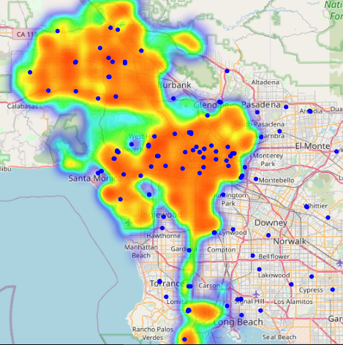
As Is
Visualize hospital locations and collision intensity
High intensity collision patches without hospitals
Blue dots denote hospital locations and the heatmap shows the intensity of traffic collisions (orange is the highest intensity)
It can be seen that collision intensity tends to higher in the central regions as compared to the outskirts

Slide 8
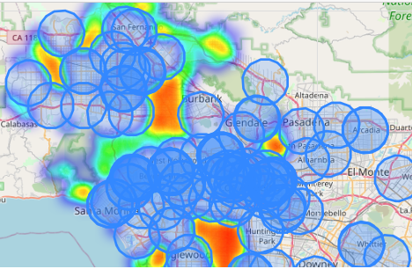
Gap Analysis
Visualize hospital coverage circles and existing coverage gaps
More accurate representation of gaps after incorporating existing hospital coverage circles
Coverage radius of an individual hospital is set at 12 kilometres. Blue circles denote the coverage of an individual hospital.
Existing Hospital Coverage = 81% and Coverage Gap = 19%
In other words, 19% of traffic accidents occurred more than 12 kms away from any existing hospital.

Slide 9
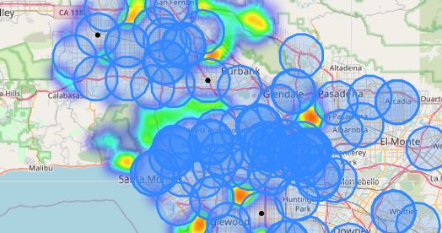
To Be (Proposed Solution)
Propose new hospital locations and quantification of their impact
Proposed Hospital No. 3
(Lat: 34.2356, Long: -118.5864)
Proposed Hospital No. 2
(Lat: 34.1674, Long: - 118.3859)
Proposed Hospital No. 1
(Lat: 33.9672, Long: -118.2884)
Adding the 3 proposed hospitals increases the coverage from 81% to 93%
(assuming that future traffic collisions follow similar pattern as the last 4 years)

Slide 10
Discussion
What is the contribution of each proposed hospital to the overall coverage?
Hospital No. 1 provides the most coverage benefit and we see diminishing returns with further additions
Funding Options
Proposed Hospital No. 1 and Hospital No. 2 are located in relatively central areas of the city
The health needs of residents nearby to Proposed Hospital No. 1 and No. 2 are unfulfilled currently, as there are no hospitals nearby
Both these hospitals are likely to be commercially viable for private players, as they can cater to all the basic health needs of nearby residents (not just limited to accident victims).
Proposed Hospital No. 3 is situated at the outskirts, so may not be commercially viable for private players
The local administration can choose to fund a smaller scale hospital for Proposed Hospital No. 3

Slide 11
Recommendations
If the target is to achieve 85% coverage:
Building Proposed Hospital No. 1 is enough to surpass the 85% coverage target
If the target is to achieve 90% coverage:
Build Proposed Hospital No. 1 and Proposed Hospital No. 2, preferably funded and operated by private players
If 3 new hospitals can be built:
Coverage level of 93.24 % can be achieved with 3 new hospitals
It can be built preferably through private players with city administration role limited to ensuring availability of space and permissions
Proposed Hospital No. 1 can be full scale hospital catering to all basic health needs of nearby residents
In case private funding cannot be secured, local administration resources should be prioritized for proposed No. 1, then No. 2
In case private funding cannot be secured, local administration resources should be prioritized for this hospital
Both these can be full scale hospitals catering to all basic health needs of nearby residents
Proposed Hospitals No. 1 and 2 can be full scale hospitals, built preferably through private players
Proposed Hospital No. 3 can be smaller scale and may need to be built through public-private partnership or fully public owned
In case private funding cannot be secured, local administration resources should be prioritized according to the hospital number

Slide 12
Conclusion
Final Remarks
Considering recent historical collision data from 2016, existing hospitals offer a coverage for 81% of the collisions
Thus 19% of recent collisions occurred more than 12 km away from the nearest hospital
Collision intensity tends to be higher in the central city regions as compared to the outskirts
Assuming that future traffic collisions will also follow a similar pattern as recent years - Adding just one hospital can improve the coverage to 89%, adding two can lead to 92% and adding 3 can lead to 93% coverage
New Hospitals must be prioritized in the order of their individual coverage benefit. Hence No. 1 has the top priority and No. 3 has last
The local administration must seek private ownership model to conserve its resources. Proposed Hospitals No. 1 and No.2 are attractive candidates, being located in relatively central regions of the city and their services will not be limited to traffic collisions only
Proposed Hospitals No. 1 and No. 2 can be full scale hospitals catering to all the basic health needs of the nearby residents
Being located towards the outskirts, Proposed Hospital No. 3 can be a smaller scale hospital and can be funded through public – private partnership model or fully public owned

Slide 13
End of Presentation

